Slide 1


Topic: N-Bit parallel and Serial adder

Slide 2
Content
N-Bit Parallel Adder
FOUR-BIT BINARY PARALLEL ADDER
Ripple-carry adder
Limitations
Serial binary adder
Difference between serial and parallel adder
References

Slide 3
N-Bit Parallel Adder
The Full Adder is capable of adding only two single digit binary number along with a carry input.
But in practical we need to add binary numbers which are much longer than just one bit.
To add two n-bit binary numbers we need to use the n-bit parallel adder. It uses a number of full adders in cascade.
The carry output of the previous full adder is connected to carry input of the next full adder.
If all input bits of the two numbers (A & B) are applied simultaneously in parallel, the adder is termed a Parallel Adder.

Slide 4
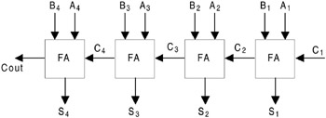
FOUR-BIT BINARY PARALLEL ADDER
Fig.(a) 4- Bit Parallel adder[7]

Slide 5
1 | In the only half-adder, inputs of 1 and 1 give us 0 with a carry of 1.
2 | In the first full-adder (going from right to left), the inputs of 1 and 0 plus the carry of 1 from the half-adder give us a 0 with a carry of 1.
3 | In the second full adder, the inputs of 0 and 1 plus the carry of 1 from the previous full-adder give us a 0 with a carry of 1.
4 | In the third and final full adder, the inputs of 1 and 1 plus the carry of 1 from the previous full-adder give us a 1 with a carry of 1.
5 | Since there are no more numbers to add up, and there is still a carry of 1, the carry becomes the most significant bit.
6 | The sum of 1101 and 1011 is 11000.

Slide 6

Ripple-carry adder
Fig.(a) Ripple carry adder [1]

Slide 7
Ripple-carry adder
It is possible to create a logical circuit using multiple full adders to add N-bit numbers.
Each full adder inputs a Cin, which is the Cout of the previous adder.
This kind of adder is called a ripple-carry adder, since each carry bit "ripples" to the next full adder.
Note that the first (and only the first) full adder may be replaced by a half adder (under the assumption that Cin = 0).

Slide 8
Ripple-carry adder
The gate delay can easily be calculated by inspection of the full adder circuit. Each full adder requires three levels of logic.
In a 32-bit ripple-carry adder, there are 32 full adders, so the critical path (worst case) delay is 2 (from input to carry in first adder) + 31 * 3 (for carry propagation in later adders) = 95 gate delays.

Slide 9
Ripple Carry adder
The general equation for the worst-case delay for a n-bit carry-ripple adder is
The delay from bit position 0 to the carry-out is a little different:
The carry-in must travel through n carry-generator blocks to have an effect on the carry-out
A design with alternating carry polarities and optimized AND-OR-Invert gates can be about twice as fast.

Slide 10
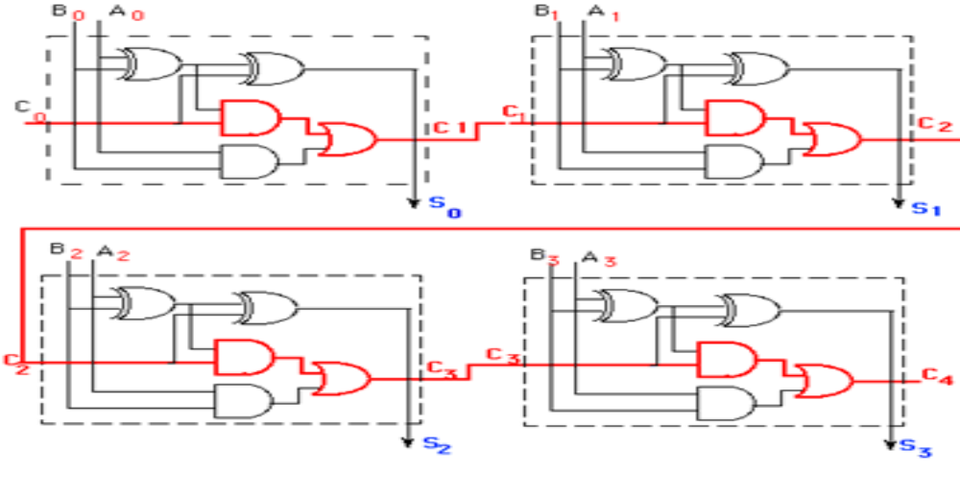
Ripple carry adder.
Fig.(a) Ripple carry adder- logic circuit[10]

Slide 11
Parallel Adder
This propagation delay is a limiting factor on the adder speed.
The signal from the input carry to the output carry propagates through an AND gate and OR gate, which constitute two gate levels. If there are four full adders, the output carry would have 2 x 4 = 8 levels from C0 to C4.
The total propagation time in this 4-bit adder would be the propagation time in one half adder (which is the first half adder) plus eight gate levels.
Assuming that all the different types of gates have same propagation delay, say T, the propagation delay of adder can be generalized as (2n + 1) T, where n is the number of stages. In this example, n = 4, so the delay is (2 x 4 + 1) T = 9T

Slide 12
Limitations
Since all other arithematic operations are implemented by successive additions, the time consumed during addition process is very critical.
For fast applications, a better design is required. The carry-look-ahead adder solves this problem by calculating the carry signals in advance, based on the input signals.

Slide 13
Serial binary adder
The serial binary adder or bit-serial adder is a digital circuit that performs binary addition bit by bit.
The serial full adder has three single-bit inputs for the numbers to be added and the carry in. There are two single-bit outputs for the sum and carry out.
The carry-in signal is the previously calculated carry-out signal. The addition is performed by adding each bit, lowest to highest, one per clock cycle.

Slide 14
Serial Binary Addition
Serial binary addition is done by a flip-flop and a full adder.
The flip-flop takes the carry-out signal on each clock cycle and provides its value as the carry-in signal on the next clock cycle.
After all of the bits of the input operands have arrived, all of the bits of the sum have come out of the sum output.

Slide 15
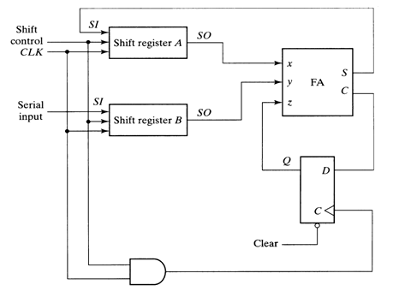
Fig. (b) Serial adder [2]

Slide 16
Difference between serial and parallel adder
Serial adder:
1) Slower
2) It uses shift registers
3) IT requires one full adder circuit.
4) It is sequential circuit.
5) Time required for addition depends on number of bits.
Parallel adder:
1) Faster
2) It uses registers with parallel load capacity
3) No. of full adder circuit is equal to no. of bits in binary adder.
4)It is a combinational circuit
5)Time required does not depend on the number of bits

Slide 17
References
[1.] M. Morris Mano, Digital Logic and Computer Design, Prentice-Hall 1979, 0-13-214510-3 , pp.119-123
[2.] A. Anand Kumar, Fundamentals of Digital Circuits, PHI Learning Private Limited,Second Edition June2011,
pp.298
[3.] Geoffrey A. Lancaster (2004), Excel HSC Software Design and Development. ,Pascal Press., p. 180.,ISBN 9781741251753
[4.] Burgess, N. (2011). ,Fast Ripple-Carry Adders in Standard-Cell CMOS VLSI". , 20th IEEE Symposium on Computer Arithmetic,p. 103–111.
[5.] www.yenka.com/help/parallel&serialadder/
[6.] www.answers.com/Q/compariaion_of_serial_adder_and_parallel_adder
[7.] www.globalsepec.com/references/58767/203279/5-9-four-bit-binary-parallel-adder
[8.] www.tutorialpoint.com/computer_logical.../combitional_circuit.pdf
[9.] www.faculty.kfupm.edu.sa/col/elrabaa/coe/200/essons/lesson3_2.pdf

Slide 18


